Slide 1
Embedded Network Design
Adam Hussain Ioannis Anastasiou Matt King

Slide 2
Project Aims
Temperature and light sensors
Manual control of heating and lighting
Integral display of key system data
Intrusion detection mechanisms and access control
Logging of system data with time (so as to allow time histories of temperature and light levels)
Intelligent monitoring systems to switch lights and heating off in unoccupied areas
Wireless communication between different units (e.g. between an entry unit and a room unit)

Slide 3
Project Outcomes
Temperature and light sensors
Manual control of heating and lighting
Integral display of key system data
Intrusion detection mechanism

Slide 4
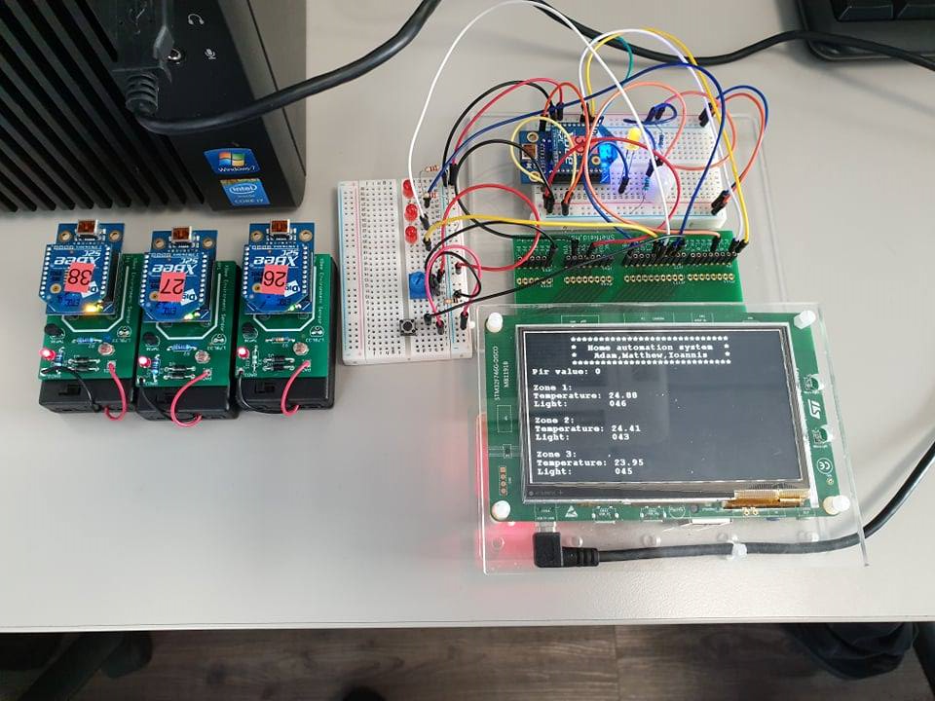
Demo

Slide 5
What Steps did we take
Group programming sessions
Group planning time before starting the programming
breakdown of tasks for fair allocation of work

Slide 6
What could have been done better
Logging of system data with time (so as to allow time histories of temperature and light levels)
Intelligent monitoring systems to switch lights and heating off in unoccupied areas
Wireless communication between different units (e.g. between an entry unit and a room unit)
Access control

Slide 7
Any Questions

